Slide 1
Low Power LDPC Decoder with Efficient
Stopping Scheme for Undecodable Blocks
Tinoosh Mohsenin², Houshmand Shirani-mehr¹, Bevan Baas¹
¹University of California, Davis
²University of Maryland Baltimore County
Notes:
In this talk I present two design projects that illustrate cross-domain optimization of algorithms, architectures and VLSI implementations for high performance and energy efficient communication applications.

Slide 2
LDPC Codes and Their Applications
Low Density Parity Check (LDPC) codes have superior error correction performance
Standards and applications
  10 Gigabit Ethernet (10GBASE-T)
  Digital Video Broadcasting (DVB-S2, DVB-T2, DVB-C2)
  Next-Gen Wired Home Networking (G.hn)
  WiMAX (802.16e)
  WiFi (802.11n)
  Hard disks
  Deep-space satellite missions
10⁰
10⁻¹
Uncoded
10⁻²
Bit Error Probability
LDPC
10⁻³
3 dB
Convolutional
10⁻⁴
3 dB
0 1 2 3 4 5 6 7 8
Signal to Noise Ratio (dB)
Figure courtesy of B. Nikolic, 2003 (modified)
Notes:
Low density parity check (LDPC) codes have received a lot of attention due to their significant error correction performance. The plot shows the bit error probability of a system using LDPC, or a convolutional coding or noncoded and as you see here, there is a 3 dB gain over convolutioanal coding and 6 db over uncoded system. Due to this large coding gain LDPC has been adopted by recent communication standards such as 10 Gigabit ethernet, Wimax and digital video broadcasting have adopted LDPC coding.
WirelessPersonal Area Networks
LDPC codes have been recently used in Hard disks and deep space communication.
These applications must operate within a limited power budget, so reducing power dissipation of LDPC decoder is crtical.

Slide 3
Message Passing: Variable node processing
α: message from check to variable node
β: message from variable to check node
λ is the original received information from the channel
Notes:
LDPC codes are defined by a large binary matrix, which is called H matrix or parity check matrix. The matrix is mapped to a graph where each row is for one checknode shown by C and each column is for one variable node shown by V here. The decoder uses an iterative message passing, which performs check node processing and variable node processing. For Variable node processing, each variable node adds the check node messages which are alpha and the received information from channel which is lambda and pass the sum back to the check nodes.
As you noticed, the check node and variable node processing steps do not require very sophisticated operations,. However, The major challenge is mapping these processing nodes in to hardware in order to minimize the communication between these nodes meanwhile provide the smallest circuit area, highest throughput and energy efficiency.

Slide 4
Message Passing: Check node processing (MinSum)
After check node processing, the next iteration starts with another variable node processing
(begins a new iteration)
Sign
Magnitude
Notes:
Since there is not much time I don’t go to details of the original decoding algorithm. Assume the inputs to the check node processors are called beta, each check node computes the sign value and minimum value among other connecting variable nodes except itself and sends outputs that are alpha back to each of them.
These two steps repeat until all errors are corrected or it reaches a maximum number of decoding iterations.
As you noticed, the check node and variable node processing steps do not require very sophisticated operations,. However, The major challenge is mapping these processing nodes in to hardware in order to minimize the communication between these nodes meanwhile provide the smallest circuit area, highest throughput and energy efficiency.
For example check node 1, finds the sign and minimum value for V6, V8 and V10 and pass it to V3, and it repeats this step for the other three Variables nodes.
To reduce the number of computations, instead of computing minimum for each group, we find the first minimum and second minimum among all 4 variable nodes here and then pass them to variable nodes.

Slide 5
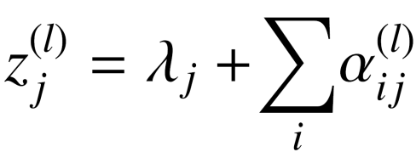
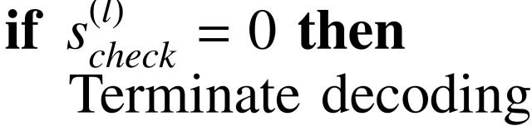
Early Termination for Decoder Convergence
With early termination a high energy efficiency for a variety of SNRs can be achieved
Existing work to detect undecodable blocks requires the knowledge of SNR or adds large hardware complexity [1] [2] [3] [4].
[1] Z. Kai et al., 2008
[2] L. Z.Cui et al., 2007
[3] D. Shin,et al., 2007
[4] J. Li et al.,2006
Notes:
In addition to decoding architecture, One efficient technique to reduce the energy dissipation and decoding latency is through controlling the number of decoding iterations that a block requires for a successful decoding convergence. The common method is to verify if the computed codeword satisfies all
parity check constraints, at the end of each iteration. The decoded messages are estimated with a
codeword bit xˆj (mapping +1 to 0 and -1 to 1). The parity checksum value (checksum(i)) corresponding to check node
Ci is computed by Eq.6, where L represents binary addition. Syndrome (s(l) check) is found by adding all checksum(i) values
according . If checksum(i) = 0 for every check node Ci, a valid code is found and the decoding process can be
terminated.
Once convergence has been verified, the decoding process is terminated.
However at low SNR ranges it happens frequently that
a block can not converge to a valid codeword even after a
maximum number of decoding iterations (Imax). Thus early
detection of an undecodable block is desired to avoid unnecessary
iterations and therefore to reduce power dissipation and
decoding latency.

Slide 6
LDPC Decoder Design Goals and Features
Key goals
  Very high throughput and energy efficiency
  Area efficient (small circuit area)
  Good error performance
Contributions
  Termination scheme for undecodable blocks
    Very low complexity
    Nearly no error performance loss
  Split-Row Threshold decoding
    Reduced interconnect complexity
    Reduced processor complexity
Notes:
The key goals of this work are to design a very high throughput and high energy efficiency decoder with small area and has a good error performance. To achieve these goals I talk about two methods that we used: First a scheme that detects undecodable blocks and terminates decoding before it reaches maximum iteration count. Next, we use our proposed decoding called Split-Row decoding which significantly reduces interconnect complexity Reduced processor complexity.

Slide 7
Outline
Iterative LDPC Decoding
Termination Scheme for Undecodable Blocks
Split-Row Threshold Decoding
  Decoder Implementations and Results
Conclusion
Notes:
Next I talk about Termination Scheme for Undecodable Blocks

Slide 8
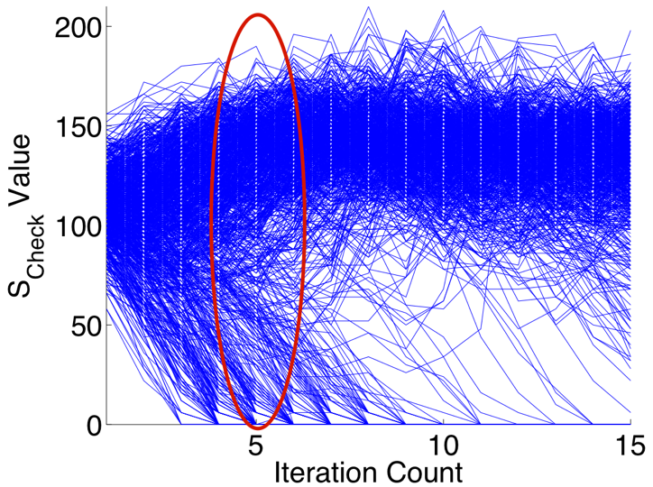
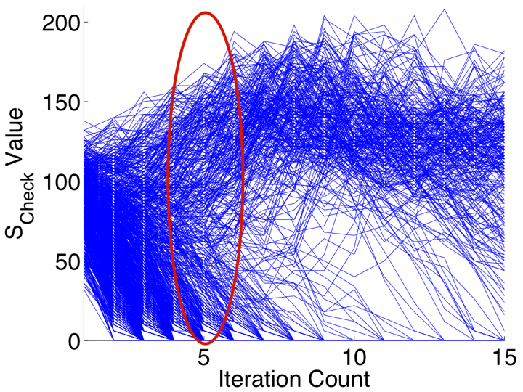
Proposed Stopping Method
SNR = 3.6 dB
SNR = 4.0 dB
A block is most likely decodable if checksum value (S_{Check}) monotonically decreases as decoding iteration count increases [1], [2].
By checking checksum value in marked region, undecodable codewords can be identified.
Results for (6,32) (1723,2048) 10GBASE-T code
[1] Z. Kai et al, 2008
[2] L. Z.Cui et al, 2007
Notes:
It is shown that the block is most likely decodable if syndrome value (sCheck) monotonically decreases as decoding
iteration count (l) increases [6], [3]. In contrast, for undecodable
blocks, sCheck fluctuates in a range of magnitudes. Figure 1
shows the variation of checksum for a (6,32) (2048,1723)
LDPC code versus iteration count, at SNr 3.6 and SNR=4.0 dB for 1000
blocks. As shown in the figure, for majority of correctable
blocks s(l) check starts decreasing within iteration interval of 4 to 6.

Slide 9
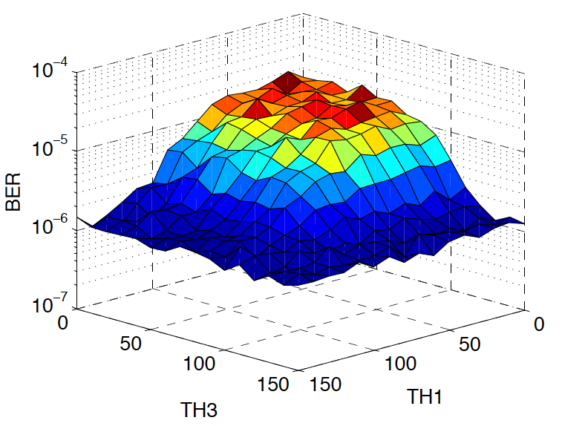


Threshold Determination
Checksum values for three consecutive iterations are compared with predefined TH1, TH2, and TH3 values.
The iteration check and threshold values are obtained by simulations.
BER results for (6,32) (1723,2048) 10GBASE-T code at SNR=4.3 dB.
Optimum threshold values are between 100-120.
Notes:
Based on this observation, the algorithm works as follows:
at the end of each iteration, it computes the syndrome (s(l) check) from decoded bits ˆx. If s(l)
check = 0 , it means decoder has converged and decoding process is terminated. Otherwise, if current iteration is a predefined number (iteration check),
It checks the syndrome of the current iteration and two previous ones with three predefined Threshold values.
If s(l) check is larger than all three values for corresponding iterations it implies
that the decoder most probably can not converge within maximum number of iterations therefore it terminates decoding. The optimum values for itercheck, TH1, TH2 and TH3 are obtained by simulations.
Fig. 2 plots the bit error performance
(BER) of a (6,32) (2048,1723) versus TH1 and TH3 values
at SNR=4.3 dB.
The error performance depends strongly on the choice of
threshold values. If the threshold values TH1, TH2 and TH3
are very large, it is less likely that this Condition can be met and
therefore algorithm converges to original Split-Row Threshold,
thus the error performance and average iteration remain the
same. On the other hand, if the threshold values are very
small, Condition 1 is always met which results in decoder termination before maximum number of decoding iterations
and therefore error performance becomes worse.
The optimum values for itercheck, TH1, TH2 and TH3 are
obtained by empirical simulations. Maximum number of iterations Imax is 15. For
the 2048-bit 10GBASE-T code using Split-Row Threshold,
itercheck = 6, TH1 = 120, TH2 = 95 and TH3 = 100
result in optimum error performance and average iteration
count. To further illustrate the impact of the threshold value
on error performance, As shown in the figure, for TH1 and TH3
larger than 100, there is no significant improvement on the
BER indicating that the error performance is near to that of original decoding performance.

Slide 10
Outline
Iterative LDPC Decoding
Termination Scheme for Undecodable Blocks
Split-Row Threshold Decoding
  Decoder Implementations and Results
Conclusion
Notes:
Next I talk about Split row threshold which improves the error correction performance of split-Row

Slide 11
MinSum vs. Split-Row Threshold Decoding
MinSum decoding
each message is sent with at least 6 bit wire
Split-Row Threshold decoding
0
0
1
0
1
0
0
1
0
1
0
0
1
0
0
0
1
0
0
0
1
0
1
0
Sign_{Sp0}
H
=
0
1
0
0
0
1
1
0
0
0
1
0
Sign_{Sp1}
0
0
1
1
0
0
1
0
0
0
0
1
reduction
of check processor area
1
0
0
0
0
1
0
1
0
0
0
1
Thresh_{Sp0}
reduction
of input wires to check processor
0
1
0
1
0
0
0
0
1
1
0
0
Thresh_{Sp1}
H
split
-
sp
0
H
split
-
sp
1
C
1
sp
0
C
1
sp
1
V
3
V
5
V
8
V
10
Mohsenin, et al., ICC 2009, ISCAS 2009, TCAS2010, Patent 12/605078, filed 2009
Notes:
To see how the algorithm works, the top figure shows the same parity check matrix highlighting the first row processing with a standard decoding method. As you notice, the check node takes 4 inputs across the matrix.
Notice that, commonly the codes sizes are in the range of 1000s to 10000 bits and even higher and the number of connections between each check node and variable node is larger than 4. The key idea of the Split-Row method which is shown at the bottom is to partition the check node processing into two or more blocks, where each block is simultaneously processed almost independently. So with this partitioning, The number of inputs to each check node is reduced which results in less interconnect complexity in addition each row processor area is reduced because it requires to process less number of inputs.
Note that the only information that is passed between blocks is the sign bit calculated in each partition to the next one.
Our chip implementation results indicate a significant improvement in area, speed, and energy dissipation when using split-row decoding method for larger row wieght codes.
The major problem in musm split-row is that it suffers from 0.5-0.7 db error performance loss. In the next slide I wills explain the reason for this error.

Slide 12
Error Performance for 2048-bit 10GBASE-T Code
Sum Product Algorithm
MinSum Normalized
Split-Row-2 Threshold
Split-Row-4 Threshold
Split-Row-8 Threshold
Split-Row-16 Threshold
Split-Row-2 (Original)
0.22 dB
0.12 dB
Notes:
So now we loo at the impact of number of partitioning on the error performance. afterfinding the threshold and correction factor for the code. The plot here shows the bit error probabitly of the 2048 bit code versus Signal to Noise Ratio for different coding schemes: From Right to left we have SPA and MinSum which are near optimum algorithms. Then we have Split-Row Threshold with different levels of partitioning and the last one is the Split row original.
The error performance of Split Threshold with two partitioning is very close to MinSum about 0.07 dB, from splt-2 through split-4, split-8 and split 16 threshold the error performance loss are less than 0.05 db and the total loss of Split-16 from MinSum is only 0.22 dB. As You can see split-16 threshold is still 0.12 db better than split-row original.

Slide 13
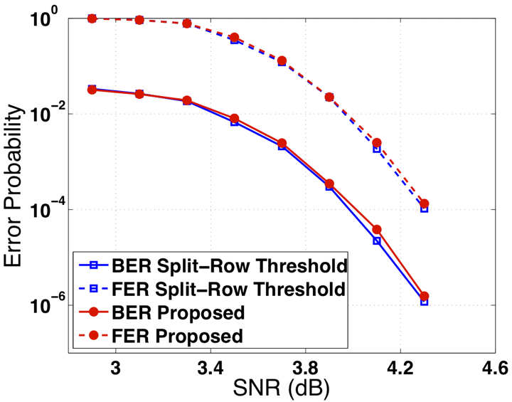
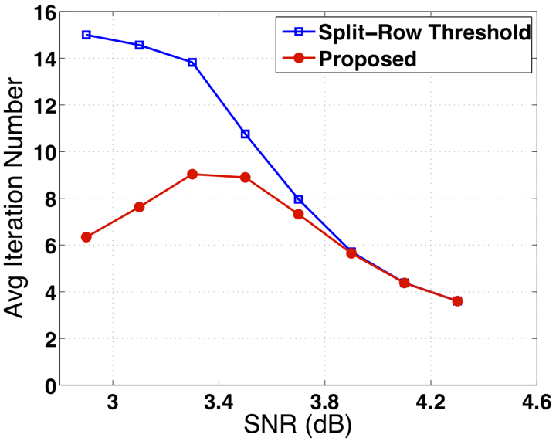
Error Correction Performance and Convergence (contd.)
0.05 dB SNR loss compared to original decoding
At SNR<3.2 dB, average no. of iterations is 2.3x smaller
Results for (6,32) (1723,2048) 10GBASE-T code
Notes:
The plot on the left shows the (BER) and frame error rate (FER) and average number of
iterations versus SNR for the the 2048-bit 10GBASE-T code
using Split-Row Threshold and the proposed stopping method
with optimum threshold values TH1 = 120, TH2 = 95 and
TH3 = 100. As shown in the figure, the proposed algorithm.
performs very closely to Split-Row Threshold with a 0.04 dB
gap at BER = 10􀀀7 and with 2.4 times less iteration at best
case.

Slide 14
Outline
Iterative LDPC Decoding
Termination Scheme for Undecodable Blocks
Split-Row Threshold Decoding
  Decoder Implementations and Results
Conclusion
Notes:
Next I talk about Split row threshold which improves the error correction performance of split-Row

Slide 15
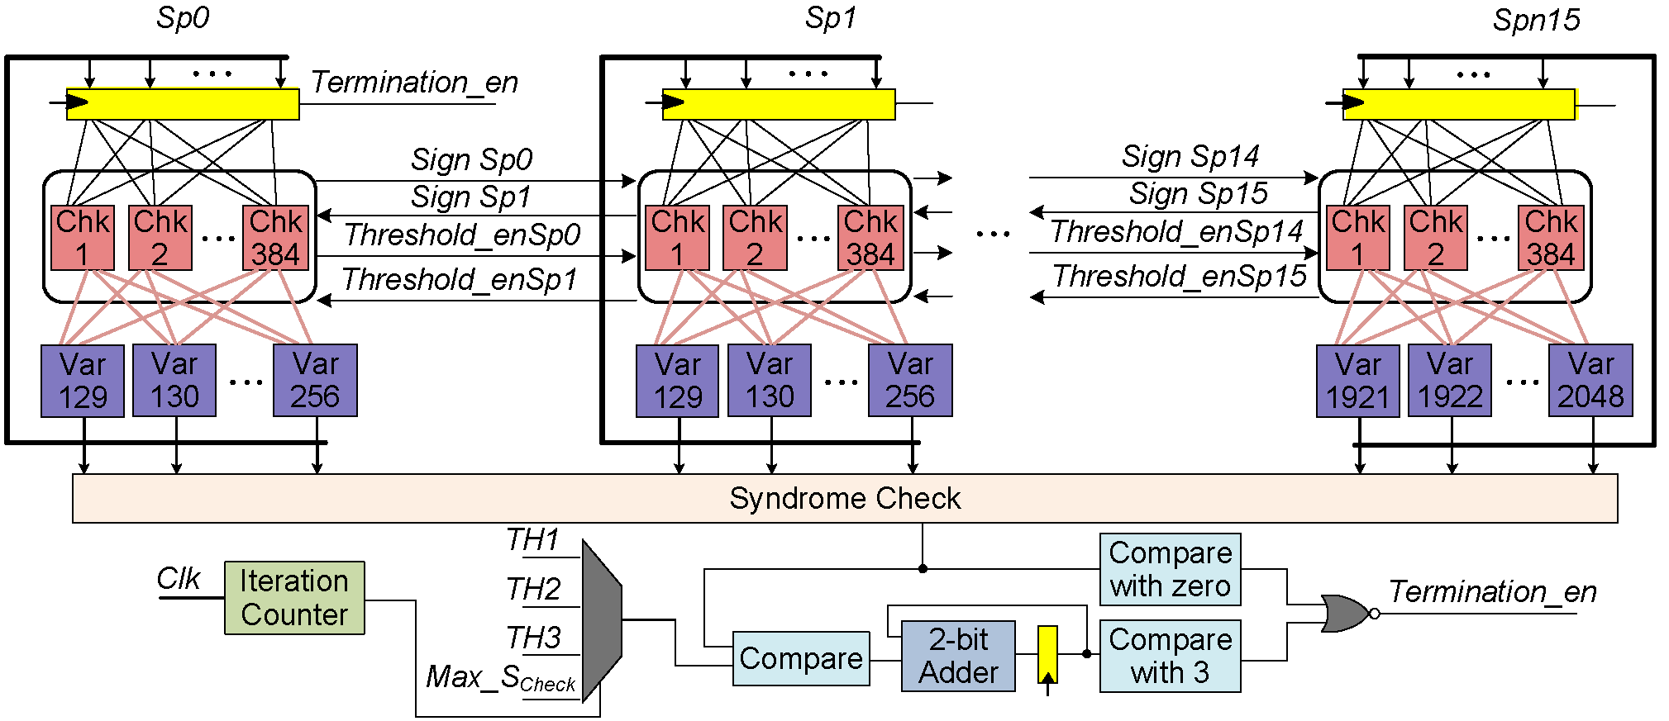
Full parallel Decoder Implementation
1
2
128
Check node partitions simultaneously compute locally, final output is updated using Sign and Threshold_en signals from nearest partition.
Implemented five full parallel decoders for (6,32) (1723,2048) 10GBASE-T code
  2048 variable processors, 384 check processors
Notes:
The block diagram of a full parallel implementation of Split-
Row Threshold decoding with the proposed stopping method
is shown in Fig. 4. The decoder consists of Spn partitions,
each partition performs check node processing in parallel and
sends its S ign and Threshold en signals to the next partition
according to Split-Row Threshold algorithm [9]. These are
the only wires passing between the partitions. In full parallel
implementation, all check and variable processor outputs are
updated in parallel, and as shown in the block diagram, it
takes one cycle to update all messages for one iteration. At
every iteration, the Syndrome check block computes S check
and compares it with zero and also with TH1, TH2, TH3 or
Max S Check at corresponding iteration (iteration = itercheck 􀀀
2; itercheck 􀀀 1 or itercheck or else). If Condition 1 is met or
S check = 0, or iteration count reaches maximum number of
iterations Imax, a signal (Termination en) is sent to registers
to disable the clock and therefore terminate decoding process

Slide 16
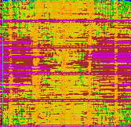
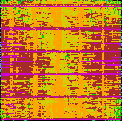
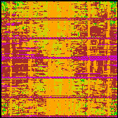
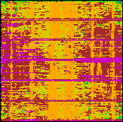
Split-Row Threshold Decoder Physical Layout
RTL
Synthesis
Power & Floor plan
Placement
Chk Proc
Var Proc
Clk tree placement
Route
Post route optimization
Notes:
We used an automatic place and route tool to implement the decoders. The diagram on the left, shows the standard cell based flow for the layout implementation of multi-split threshold decoder.. After you implemented each block we put them together, for example here shows Split threshold with 16-way partitioning decoder. Notice that, these blocks are connected with near-zero threshold and sign wires that are passed serially across the blocks.
To further analyze the impact of partitioning on the area and delay and power dissipation of the decoder chips we implemented 5 decoders using convnetioal minsum algorithm and our split threshold decoder with different partitioning using this flow.
===============================================
After writing Verilog RTL, the design is translated into gates netlist, we import the netlist into a layout tool, we deisgned the power distribution, place all the gates and design clk tree and route the celles

Slide 17
Comparison of Decoders
MinSum
Split-8
Threshold
Split-2
Threshold
Split-4
Threshold
Split-16
Threshold
10GBASE-T Code 65 nm, 7 M, 1.3 V | MinSum | Split-2 Threshold | Split-4 Threshold | Split-8 Threshold | Split-16 Threshold | Split-16 vs.MinSum
Final area utilization | 38% | 51% | 85% | 92% | 97% | 2.5x
Area (mm²) | 20 | 14 | 6.4 | 5.6 | 5.2 | ÷3.8
Speed (MHz) | 59 | 106 | 143 | 179 | 188 | 3.1x
Throughput @ 15 iter (Gbps) | 8.0 | 14.5 | 19.5 | 24.4 | 25.7 | 3.1x
Energy per bit @ 15 iter (pJ/bit) | 241 | 170 | 100 | 62 | 56 | ÷4.3
CAD route CPU time (hour) | 484 | 83 | 20 | 6.9 | 2.5 | ÷194
Notes:
And here is the layout of our 5 decoder implementations which is built using minsum, split-2, split … in 7M, 65 nm CMOS
The table summarizes the decoder implementation results for these decoders and the last column compares Split-16 against Minsum
Split-16 decoder final utilization is 97% which is 2.5 times larger, it occupies 4.8 mm^2 which is 4.2 times smaller than MinSum decoder. It runs at 195 MHz and with 15 decoding it attains 26 gbps which is 3.3 times higher
Also notice that implementation of all 16 blocks split-16 decoder takes much less time about 193 times faster when compared with minsum decoder. 20 days vs 2.5 hours.
Note that, we let the CAD tool do the automatic place and route and we used the exact same identical flow for all 5
designs. But Since Split threshold reduces check processor area and eliminates significant communication between check and variable node processors layout becomes more compact. As a result, an automatic place and route tool is very efficient.

Slide 18
Proposed Early-stopping Method Comparison
Notes:
When we add the stopping technque for the decoder. The total hardware area is increased by only 1% meanwhile the energy is incresesd by
Energy efficiency is improved by 2.4 times and

Slide 19
Conclusion
Efficient method for stopping decoding for undecodable blocks is introduced.
Split-Row Threshold decoding reduces the number of connections between check and variable processors. This results in a higher logic utilization and a smaller circuit.
Energy efficiency is improved by 2.4x for
SNR < 3.0 dB and 2.3x for SNR>4.3 dB over original decoding.

Slide 20
Acknowledgements
Support
  ST Microelectronics
  NSF Grant 430090 and CAREER award 546907
  Intel
  SRC GRC Grant 1598 and CSR Grant 1659
  Intellasys
  UC Micro
  SEM

